Slide 1

Introduction to AI(AI101B)
Predicting House Prices using supervise learning
Session 2024-25
Even Semester
Team Leader: Prabhav Kansal and (University Roll no.) : 202410116100143
Member Name: Priyanshu Kansal and (University Roll no.) : 202410116100155
Member Name: Sagar Gupta and (University Roll no.) : 202410116100174
Project Supervisor : Ms. Komal Salgotra
(Assistant Professor)

Slide 2
Content
Introduction
Methodology
Code
Screenshots Output

Slide 3
Introduction
In recent years, the real estate industry has increasingly turned to data-driven approaches to understand market trends and estimate property values. One of the most effective and widely used methods for this purpose is supervised learning, a branch of machine learning that involves training algorithms on labeled data. When it comes to predicting house prices, supervised learning models can analyze historical data — which includes features like square footage, location, number of bedrooms and bathrooms, age of the house, nearby amenities, and more — to learn the underlying patterns that influence housing costs.
By leveraging supervised learning, we not only enhance the accuracy of house price predictions but also bring transparency, speed, and efficiency to real estate valuation. This makes it an essential tool in the modern digital landscape of property buying and selling.

Slide 4
The key idea behind supervised learning is to provide the model with both input data (features of the house) and the correct output (actual sale price). The algorithm then learns the relationship between the features and the target variable. Once trained, the model can accurately predict the price of a house it has never seen before, based on similar characteristics from the training data.
This process has significant benefits. For homebuyers, it offers a more informed way to assess whether a property is reasonably priced. For sellers, it helps in setting competitive and realistic price points. Real estate agents and investors also use such models to evaluate market potential and forecast future trends.
Supervised learning techniques commonly used for this task include linear regression, decision trees, random forests, and gradient boosting algorithms. Each technique has its strengths and can be chosen based on the complexity and size of the dataset.

Slide 5
Methodology
🔹 1. Data Collection
The first step is gathering historical housing data. This dataset typically includes features such as house size (square footage), number of bedrooms and bathrooms, location (ZIP code or coordinates), age of the house, proximity to schools, crime rate, and the actual sale price (target variable). Public datasets like the Kaggle “House Prices” dataset or open government real estate data are often used.
🔹 2. Data Preprocessing
Raw data is rarely clean. Preprocessing involves:
Handling missing values (e.g., filling, removing, or imputing data),
Encoding categorical variables (e.g., location or house style),
Feature scaling (normalization or standardization),
Removing outliers that can distort the model.

Slide 6
Methodology
.
🔹3. Exploratory Data Analysis (EDA)
EDA helps in understanding relationships between features and the target variable. Visualization tools (like scatter plots and heatmaps) are used to detect correlations and trends that guide feature selection.
🔹4. Model Selection
Various supervised learning algorithms are explored, including:
Linear Regression: For understanding linear relationships.
Decision Trees and Random Forests: To capture non-linear patterns.
Gradient Boosting Machines (GBM) or XGBoost: For high accuracy with complex datasets.

Slide 7
Methodology
🔹6. Evaluation Metrics
Performance is measured using metrics like:
Mean Absolute Error (MAE)
Root Mean Squared Error (RMSE)
R² Score (coefficient of determination)
🔹5. Model Training and Testing
The dataset is split into training and testing sets (commonly 80/20). The model is trained on the training data and then evaluated using the test set.

Slide 8
Code Typed
import pandas as pd
import numpy as np
import matplotlib.pyplot as plt
import seaborn as sns
# Load the dataset
df=pd.read_csv("kc_house_data.csv", delimiter= ",")
# Display the first few rows of the dataset
print(df.head())
# Get basic information about the dataset
print(df.info())

Slide 9
Code Typed
df.isnull()
df.isnull().sum()
import numpy as np
df["bathrooms"]=np.round(df["bathrooms"])
df['date'] = pd.to_datetime(df['date'])
df["bedrooms"].value_counts()
df[df['bedrooms'] == 33]
df.loc[15870, 'bedrooms'] = 3

Slide 10
Code Typed
df["bedrooms"].value_counts()
import matplotlib.pyplot as plt
import seaborn as sns
plt.title("Histogram of Different Number of Bedrooms")
plt.xlabel("Number of Bedrooms")
df["bedrooms"].plot.hist()
plt.title("Histogram of Different Number of Bathrooms")
plt.xlabel("Number of Bathrooms")
df["bathrooms"].plot.hist()
plt.title("Histogram of Different Number of Floors")
plt.xlabel("Number of Floors")
df["floors"].plot.hist()

Slide 11
Code Typed
plt.title ("Histogram of Different Square Footage of the Living Space")
plt.xlabel("Square Footage of the Living Space")
df["sqft_living"].plot.hist()
sns.distplot(df["price"], bins=50, hist=True, kde=True)
sns.boxplot(x= "bedrooms", y="price", data=df)
sns.boxplot(x= "floors", y="price", data=df)
new_data= df.copy()
new_data= new_data.drop(["id", "date"], axis=1)
new_data.head()

Slide 12
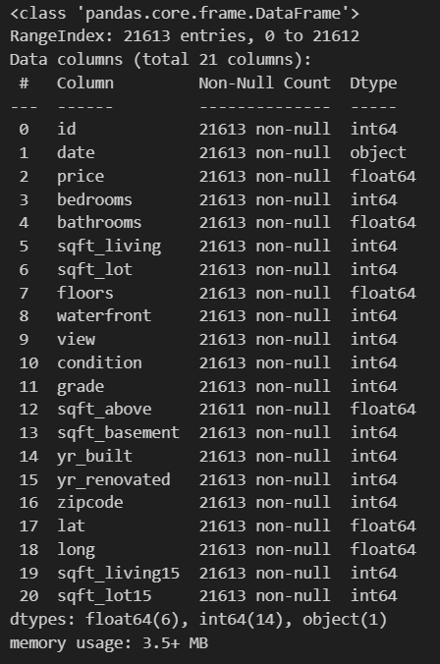
Screenshots Output

Slide 13
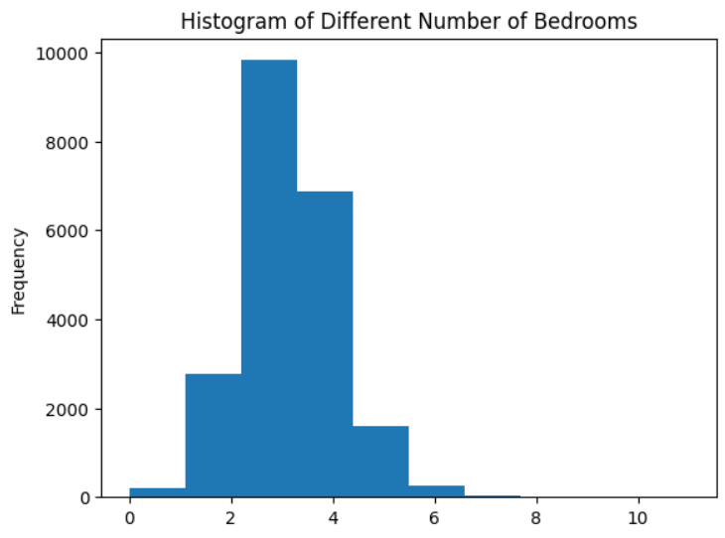
Screenshots Output

Slide 14
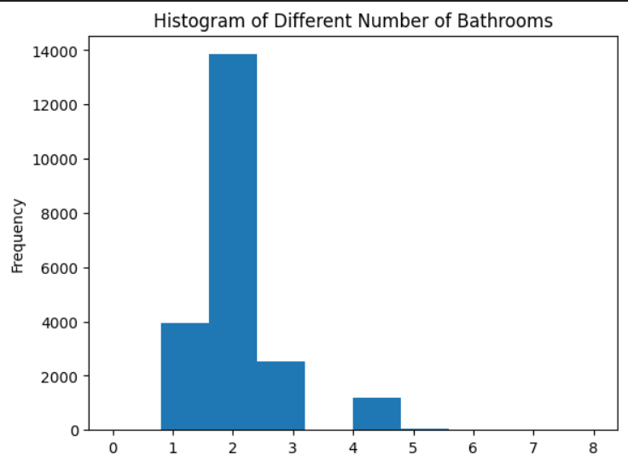
Screenshots Output

Slide 15
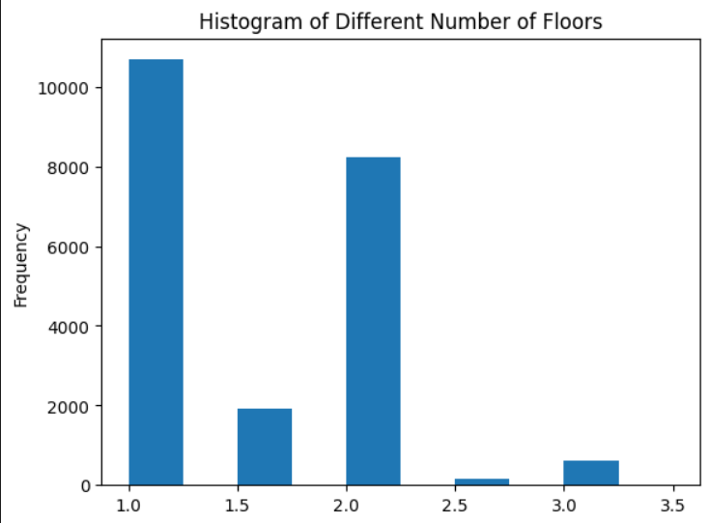
Screenshots Output

Slide 16
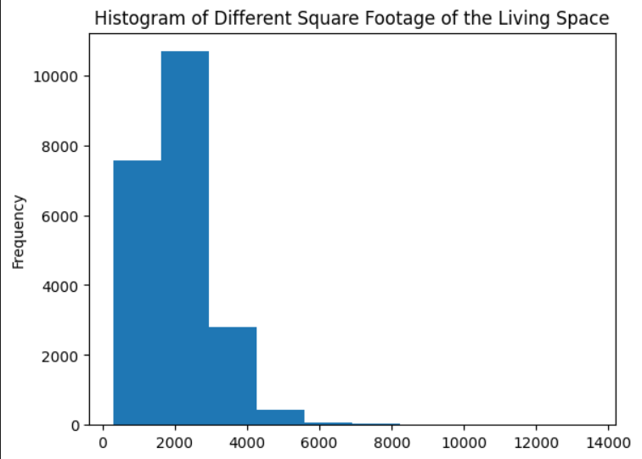
Screenshots Output

Slide 17
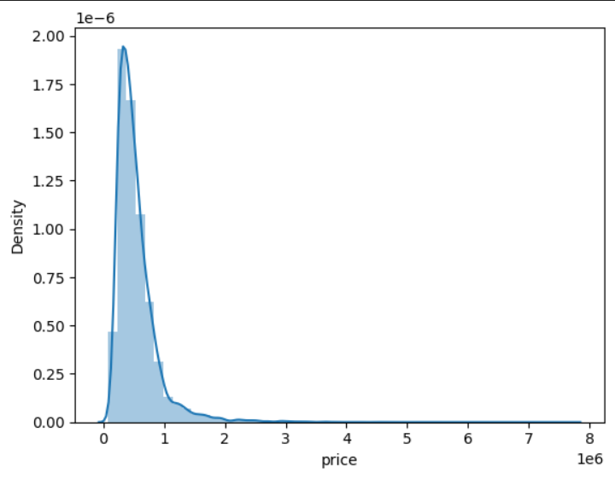
Screenshots Output

Slide 18
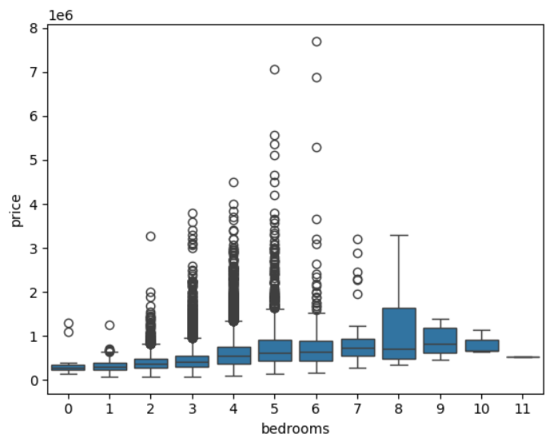
Screenshots Output

Slide 19
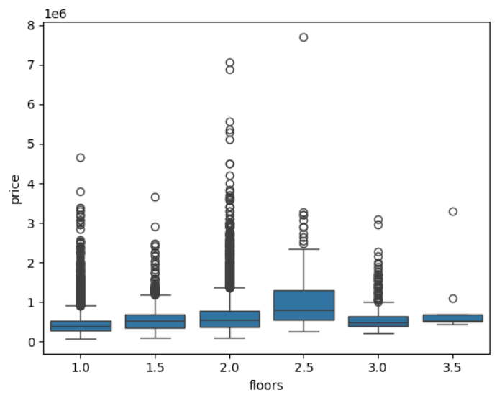
Screenshots Output

